Slide 1
Quantum correlations.
Adam W. Majewski

Slide 2
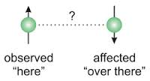
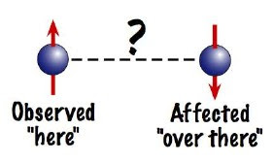
Quantum entanglement.
Quantum entanglement is a phenomenon that occurs when particles (subsystems) are generated in ways that the quantum state
of each particle can not be described independently ; BUT
Ghhjhjj

Slide 3
Quantum entanglement.
instead a quantum state may be given for a system as a whole!
The entanglement was the subject of Einstein-Podolski-Rosen paper.
Correlations should be taken into account.

Slide 4
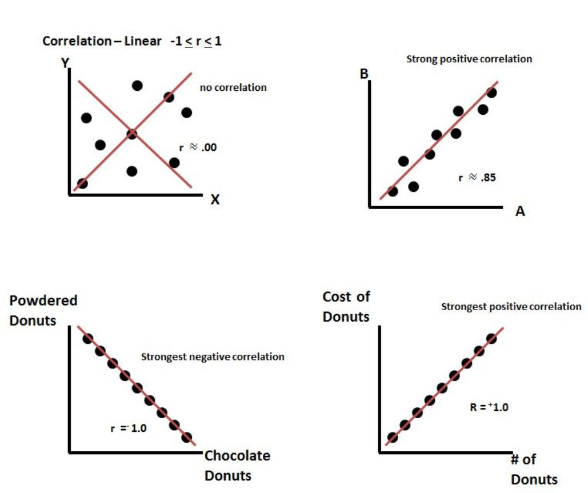
Correlations.

Slide 5
Quantum correlations.
However, quantum correlations are of different nature (cf quantum entanglement)!
To explain them one needs:
(1) to describe (classical) correlations,
(2) to give a characterization of states of a composite system,
(3) to clarify the procedure of quantization.

Slide 6
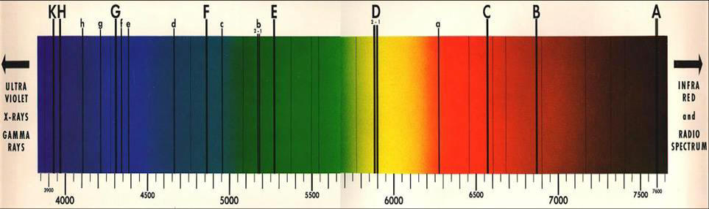
Quantization.
Heisenberg; to explain the nature of energy levels it is necessary to use non-commutative calculus!

Slide 7
Why quantum correlations are important?
An analysis of foundations of Quantum Mechanics done by Einstein, Podolski, Rosen, Schroedinger, Bell, … is employing models having entanglement.
Such studies are inevitable to get an understanding of Quantum Mechanics.
Quantum Information is based on such (quantum!) correlations. For example: quantum computers will employ such correlations.

Slide 8
What should be clarified.
(1) How to see that the concept of quantum correlations is a phenomenon stemming from the rules of quantization?
(2) How to define these correlations?
(3) How one can measure such correlations?

Slide 9
What should be taken into account?
Classical physics and classical probability,
quantum physics and quantum probability,
the structure of classical states versus the structure of quantum states,
classical composite systems and quantum composite systems,
How to obtain a state of subsystem?

Slide 10
What should be taken into account?
How to subtract classical correlations from general correlations?
How to carry out a characterization of strong quantum correlations?
The last question is very important for quantum computations.

Slide 11
How to this end?
One starts with classical probability theory:
(i) rules of probability calculus,
(ii) independence, correlations are well established concepts,
(iii) some features on measures should be given: Riemann’s approximations, product structures,
(iv) a probability measure versus a state of a system.

Slide 12
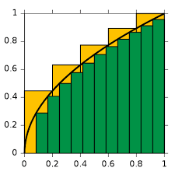
Riemann approximations:

Slide 13
Composite (compound) systems.
A composite system can be decomposed into its subsystems,
Conversely, individual subsystems can be combined to give overall composite system.
A composite system consisting of two subsystem will be called bipartite system.
Two point correlations functions are playing important role; an example:
C(x)=⟨f(x ′ +x)g(x ′ )⟩

Slide 14
Classical correlation functions.
The basic goal of this part of our lectures is to provide a general form of two point (classical) correlation functions.
This result is of paramount importance for understanding the nature of bipartite correlations!

Slide 15
Rules for quantization.
Quantization; what should be explained:
quantization of a system,
quantization of composite systems,
quantization of probability calculus,
Also one needs to understand why finite dimensional systems are only toy models in quantum theory,
And, necessity for abstract mathematical tools.

Slide 16
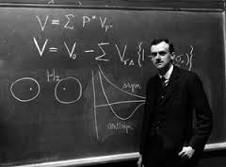
Observables and states.
Observables are represented by operators, while (pure) states by vectors (all on a Hilbert space) - the first course in Quantum Mechanics. This should be and this will be generalized. Otherwise, it is impossible to get a general theory!
Paul Dirac.

Slide 17
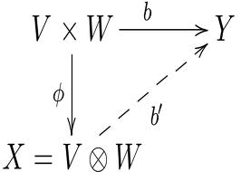
Tensor products.
The general idea of tensor product is given by:
Quantum mechanics as well as the theory of composite systems demand generalizations.
The necessity for the employment of more abstract tools (algebras, Banach spaces) .
Consequently, also a more general theory of tensor products will be necessary.

Slide 18
Mathematical tools:
A general quantum system (atom, quantum field) demands abstract description, for example: Haag-Kastler approach.
Vacuum exhibits quantum correlations.
Even to define entanglement of mixed states (density matrices) specific constructions of tensor product will be necessary.
All that tools will be given.

Slide 19
Toy models.
Toy models are employing to make simpler the modeling of a complex physical systems while preserving at least few essential features of a system.
Example: Qubits.
Within the scheme of finite dimensional models, quantization can not be done!
Toy models can lead to false statements!

Slide 20
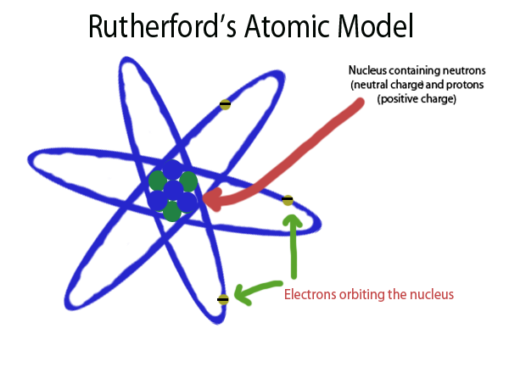
An example of a ``toy = simplified’’ model:

Slide 21
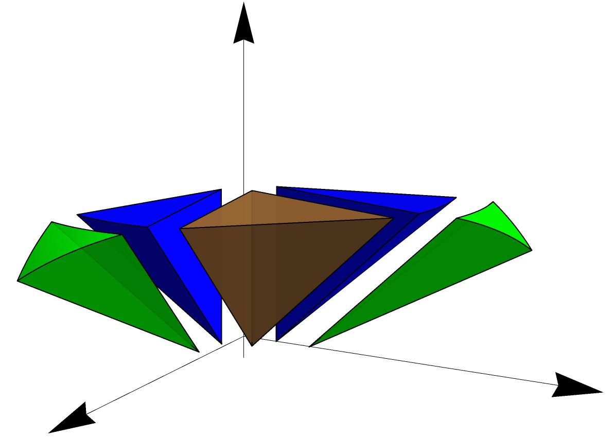
Decomposition theory.
How a state can be represented?
Can a decomposition be used? What it is?

Slide 22

Decomposition theory.
BUT there are two basic types of convex sets:
Family of (all) classical states of a system is a simplex:
Examples of simplexes:

Slide 23
Decomposition theory.
Family of (all) quantum states of a (quantum) system has not such form!
A nice example of non simplex is given by a 2-dimensional ball:
Even, in 2-dimensional ball, one can see the non-uniqueness of a convex decomposition of non-extremal points!

Slide 24
Quantum correlations.
Direct quantization of (classical) correlation coefficient can be done, BUT this quantized coefficient is not able to distinguish the difference between quantum and classical correlations.
New definition of the quantum coefficient will be given!
We will prove that the new coefficient has all necessary properties.

Slide 25
Quantum correlations.
To this end we will use both the measure theory and decomposition theory.
The satisfactory result is obtained for the C*-algebra case.
Problems with mixed states.

Slide 26
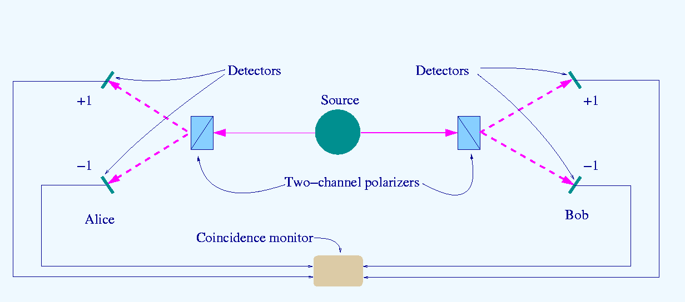
Bell inequalities.

Slide 27
Bell inequalities.
Cor(a,c) – Cor(b,a) –Cor(b,c) is not larger than 1; classically!
Cor - the correlations between measurements of the spins of pairs particles.
a,b,c refers to three arbitrary settings of two measurements.
This is just a nice indicator of quantum correlations!

Slide 28
Entanglement of Formation.
EoF is another measure of entanglement.
This measure can use the entropy function and EoF demands more subtle decompositions!
General properties of EoF will be presented.
Our analysis of EoF will be done for a general quantum bipartite system (therefore, again, algebraic structures will be essential).

Slide 29
Entanglement of formation.
Our analysis of EoF demonstrates rather strikingly that the value of EoF, for a given state, can be approximated with arbitrary precision by a measurement of carefully selected observable!

Slide 30
PPT states.
PPT state is a state such that its composition with the partial transposition is again a state.
They exhibit (very) strong quantum correlations.
We will give a detailed characterization of such states.
The given description will rely on the theory of positive maps.

Slide 31
PPT states.
For that we will use a characterization of positive maps which can be formulated within the theory of tensor products.
In that way, this type of strong entanglement will be characterized.
All that will be done for a general quantum system.

